Slide 1
Smart monitoring system for weather and tsunami detection (smstwd)
Saumya Roy, Victor Petre

Slide 2
Agenda
System mission
Problem domain analysis
TRIZ contradictions and solutions
Requirements
System context
Proposed solution

Slide 3
System mission
“ To save lives, mitigate damage, and offer peace of mind by transforming accurate monitoring into actionable intelligence on natural disasters.”

Slide 4
Problem domain alanysis (TRIZ 9 boxes), Part 1
 | -5 years | Now | +5 years
Super-system | National meteorological angencies Government disaster response agencies Broadcasters | All prior ones Private tech companies Insurance firms Cloud service providers Smart city infrastructure Smartphones and vehicles | All prior ones Autonomous transport networks Autonomous infrastructure

Slide 5
Problem domain alanysis (TRIZ 9 boxes), Part 2
 | -5 years | Now | +5 years
System | Assimilation of data for situational updates Independent operation of atmospheric, oceanic, and seismic monitoring Detection and alerting of hazards Warnings issued to multiple communication channels | Near real-time ingestion and processing of multi-source data Multi-modal data integration Probabilisic hazard estimation and risk scoring Risk scoring provided to agencies via dashboards and decision support systems Automated warnings issued to multiple channels High-frequency update cycles | Personalized evacuation routes based on real-time location relative to danger zones Triggering of pre-emptive safety mechanisms before impact High-resolution prediction at street block level Distributed decision-making for localized response

Slide 6
Problem domain alanysis (TRIZ 9 boxes), Part 3
 | -5 years | Now | +5 years
Sub-system | Satellites (4-8km resolution) Ocean buoys, slow telemetry and sparse coverage Land-based seismic networks Doppler radar Single-channel broadcast systems for emergency alerts Physics-based numerical inference models Human forecasters, no use of (Gen)AI Aircraft monitors using radio communication | Satellites (0.5-2km resolution, 30-60 sec updates) Deep sea floor level seismic networks Telemetry issues mostly fixed Faster scanning radar Fiber-optic seismic sensing along submarine cables Physics-based numerical inference models ML accelerators for onboard inference 5G, bluetooth, and wifi based emergency alert broadcast systems AI-based multilingual support GenAI-based and hybrid AI/physics forecasting models Optimized pressure sensors and water flow direction detectors Aircraft monitors with realtime satellite imagery and deep water sensor feedback | Denser ocean buoy mesh network Direct satellite-to-sensor communication modules ML models pinpointing epicentre radius for faster relief and rescue Smart IoT bunker guidance systems Nano-sensors with energy harvesting from tidal waves Seismic sensors detecting changes deep in the tectonic plates AR interfaces for guidance and relief AI chips embedded in sensors

Slide 7
TRIZ contradictions
These are just the ones we focused on, the complete matrix is available in the report
Decrease loss of time without decreasing reliability
Increase reliability without increasing energy used and/or worsening function efficiency
Increase robustness to noise without increasing system complexity

Slide 8
TRIZ Solutions, part 1
Decrease loss of time without decreasing reliability
Increase reliability without increasing energy used and/or worsening function efficiency
Both can be addressed with Principle 3: change an object’s structure from uniform to non-uniform. Instead of an aggregated inference pipeline where all data is pooled, keep inference for sensor sub-systems separate in the early stages. Also, allow inference to happen asynchronously, without waiting for new data from all modalities.
The first can also be addressed with Principle 28: mechanics substitution. Replacing mechanical water flow spinners with solid-state sensing technologies such as ultrasonic flow detectors, both speed and reliability are increased.

Slide 9
TRIz solutions, part 2
3. Increase robustness to noise without increasing system complexity
Can be addressed using Principle 6: making a part or object perform multiple functions, remove the need for multiple objects. Data from all sensors needs de-noising prior to inference, and each pipeline generally has its own specialized de-noising pipeline (increasing system complexity, possibly).
We can mitigate this by constructing a shared de-noising pipeline with configurable hyper-parameters, which allows the same de-noising interface to be used for all sensor modalities.

Slide 10
Requirements
See report and Rhapsody file! (diagram too big to fit into slides)
https://github.com/Roy-C4/SysML_Assignment
Split into functional, non-functional, and safety.
Generated using the client specifications (the assignment document), findings from 9 boxes analysis, and solutions to contradictions from TRIZ

Slide 11
System context

Slide 12
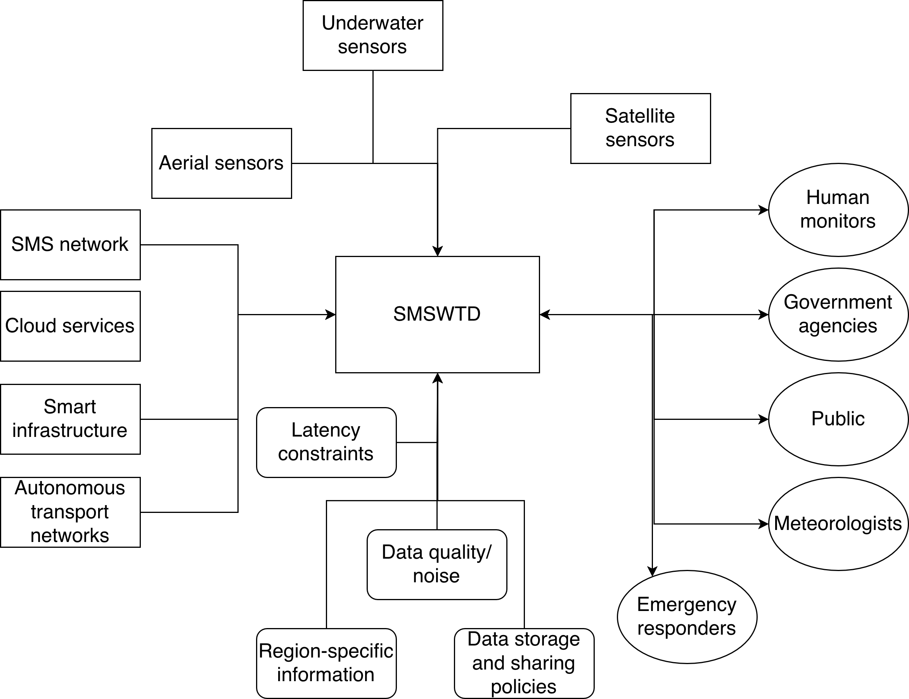

Slide 13
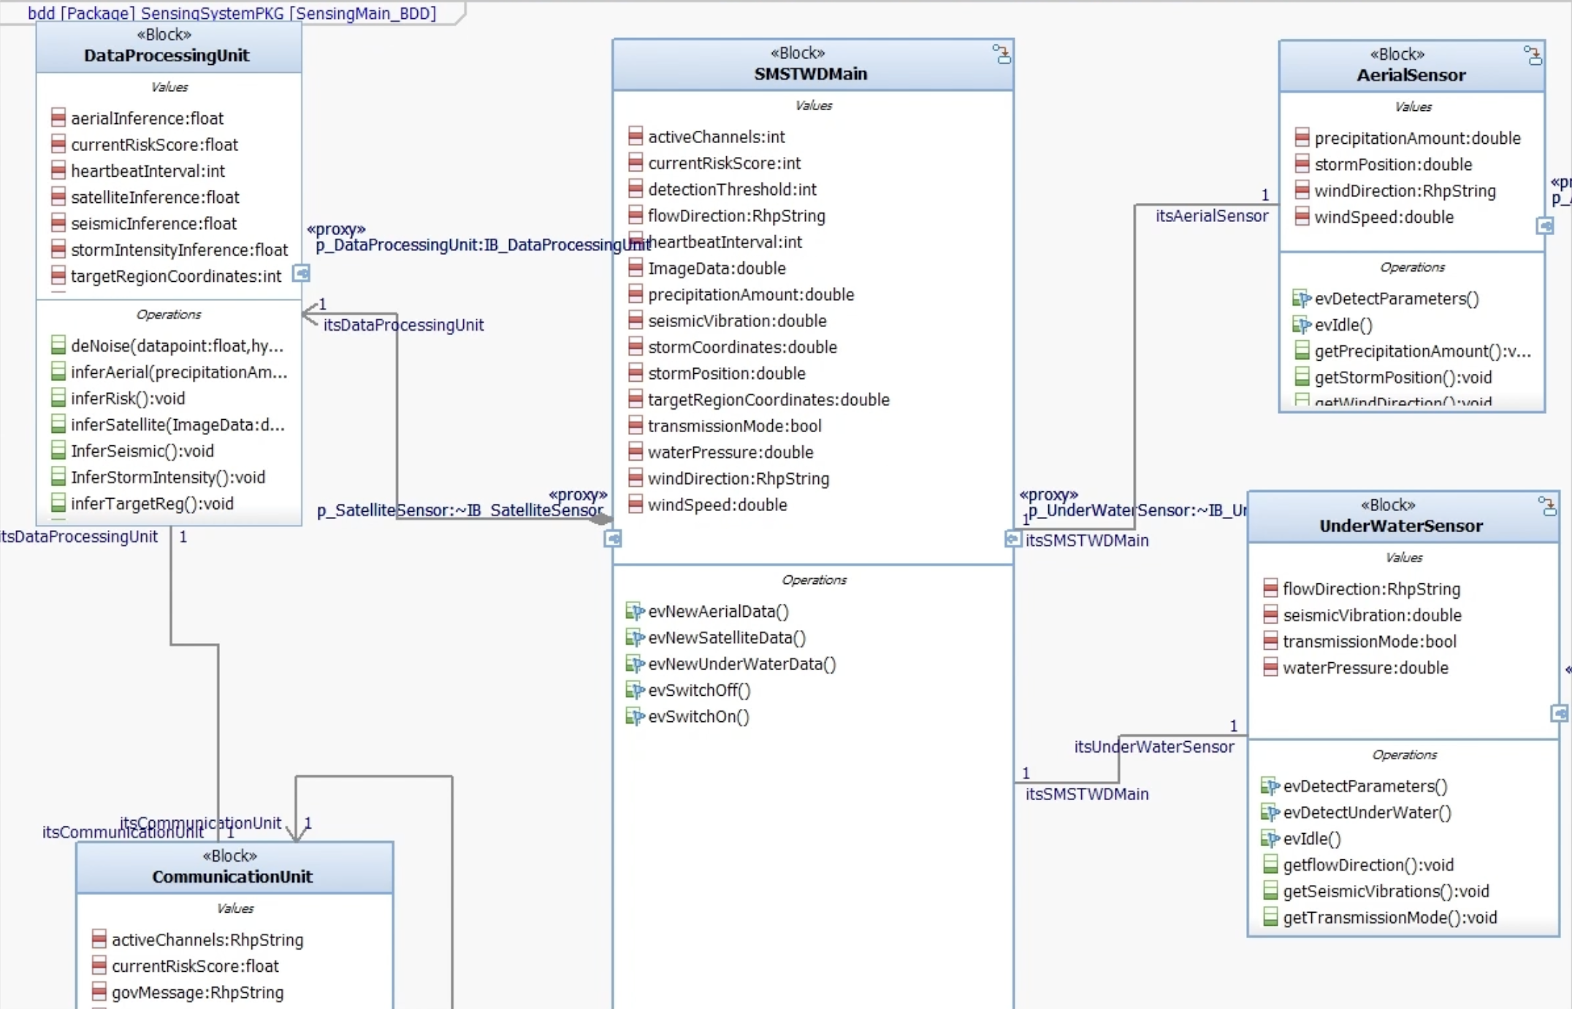
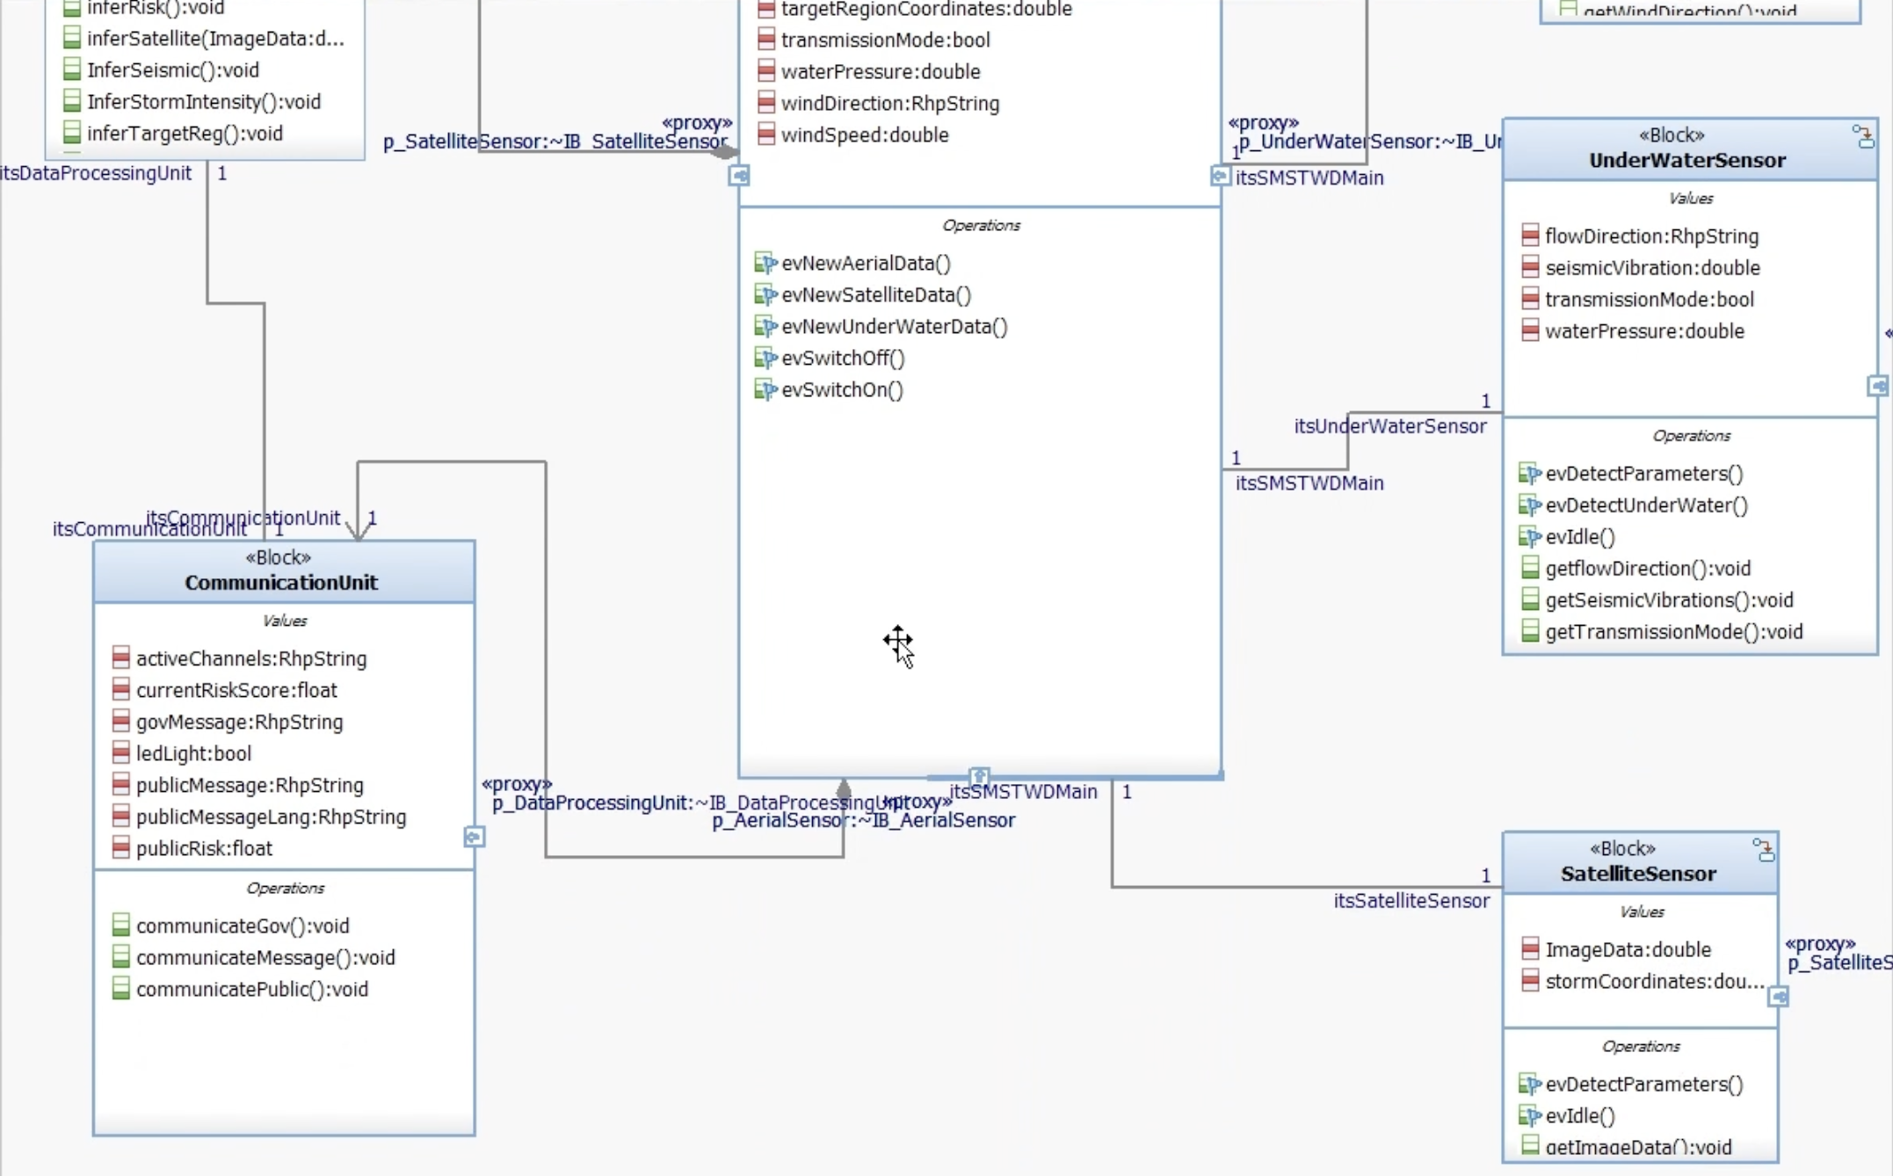
Proposed solution: BDD
Central system interfacing with sensor sub-systems, containing data analysis + communication blocks

Slide 14
Proposed solution: BDD
Shared de-noising function in the data processing block (TRIZ!)

Slide 15
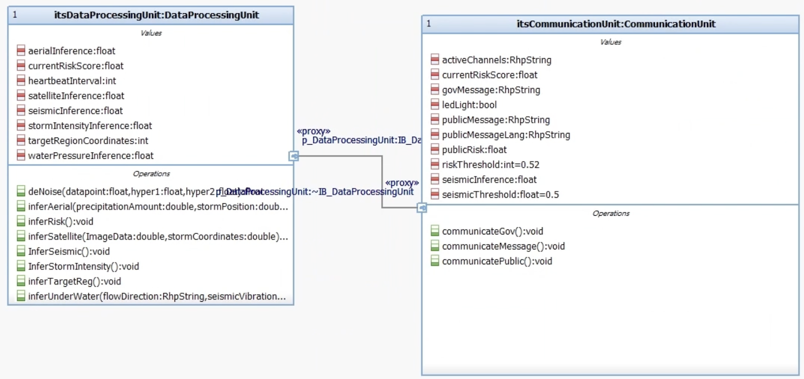
Proposed solution: IBD
Central unit SMSTWDMain contains DataProcessingUnit (performs inference) and CommunicationUnit (relays information), which communicate together via a Proxy Port

Slide 16
Proposed solution: state chart
Inference triggered whenever new data comes in from any sensor, initially separate for increased reliability (TRIZ!)
Too big to fit on one slide, see the video and the report!
https://github.com/Roy-C4/SysML_Assignment

Slide 17
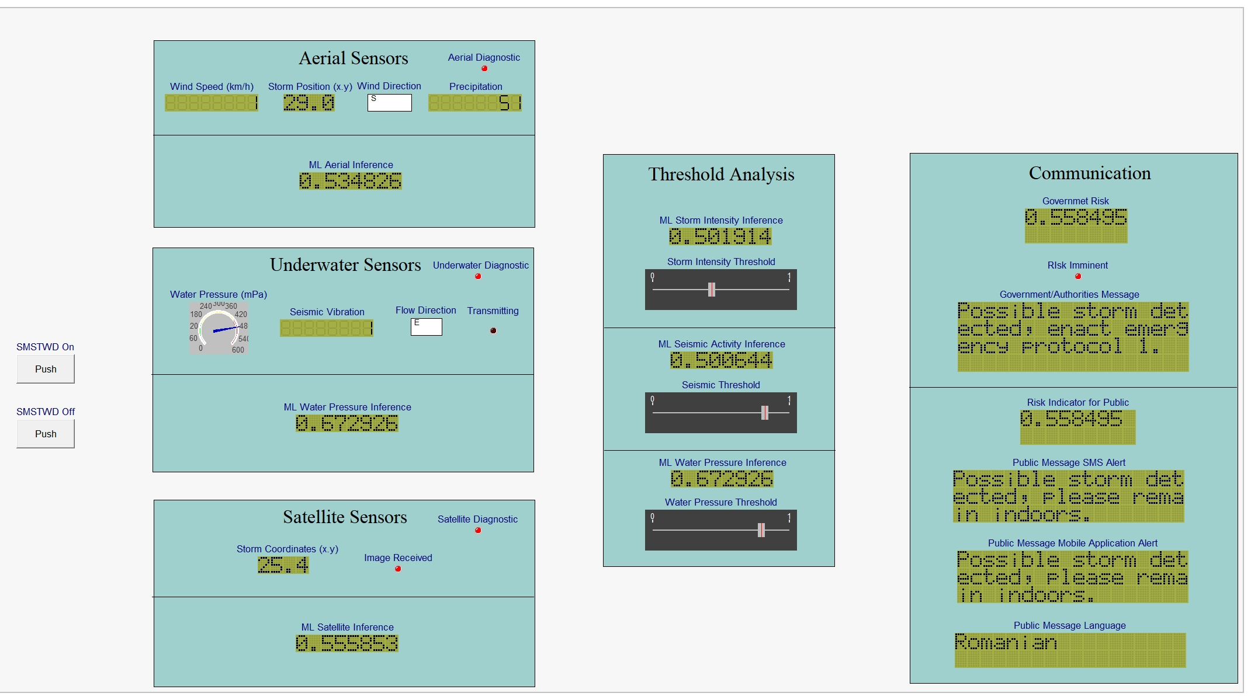
System GUI

Slide 18
Left: sensor data readings, and initial inferences
Middle: initial inferences combined into pooled inferences, then compared against thresholds
Right: pooled inferences combined into risk factor inference. This + outputs of previous thresholding are used to relay messages to the public & government

Slide 19
Thank you!

